Slide 1
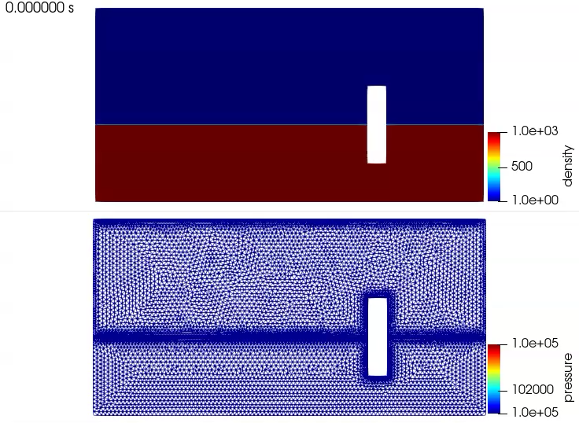
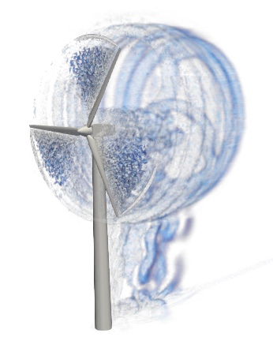
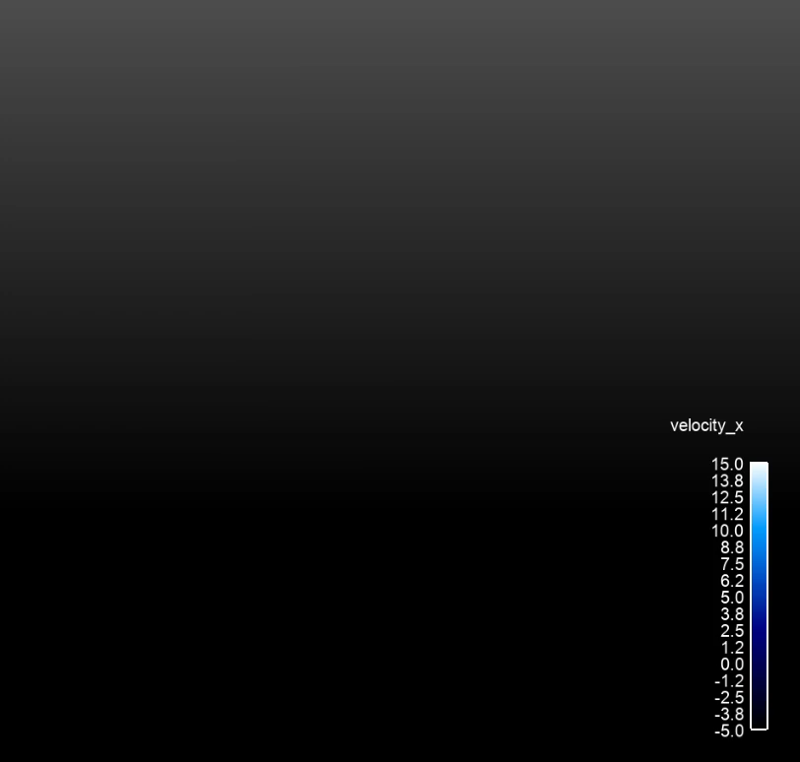
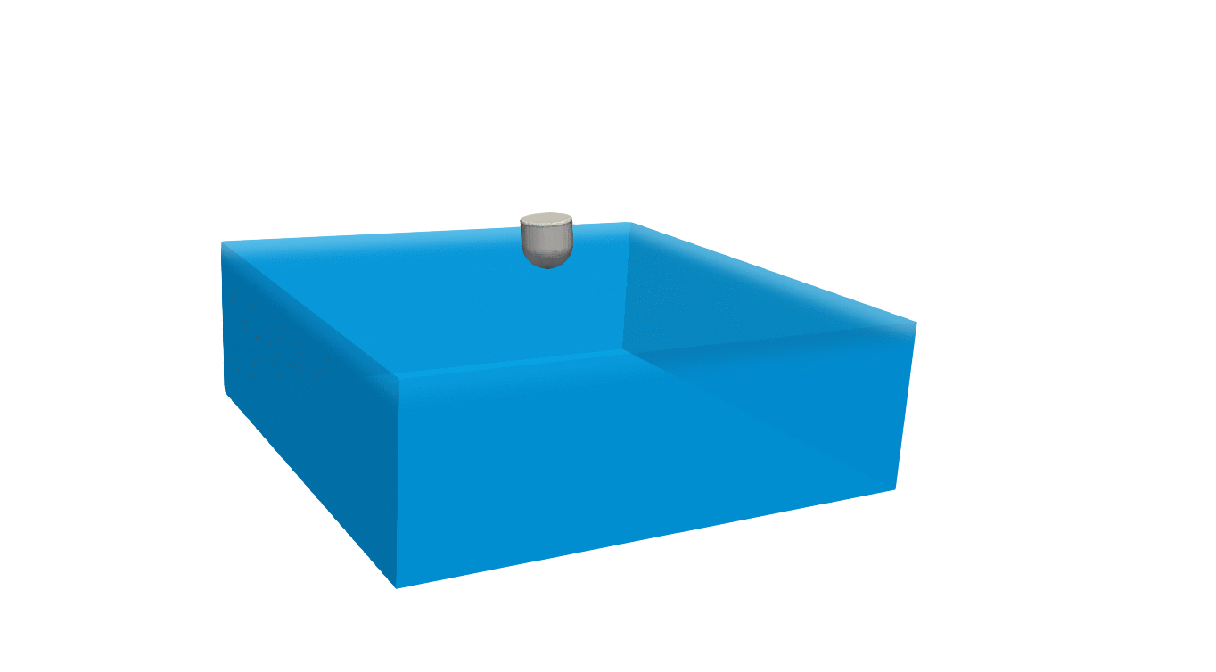
Moving Mesh Approaches
Options: sliding mesh, mesh deformation, and overset

Slide 2
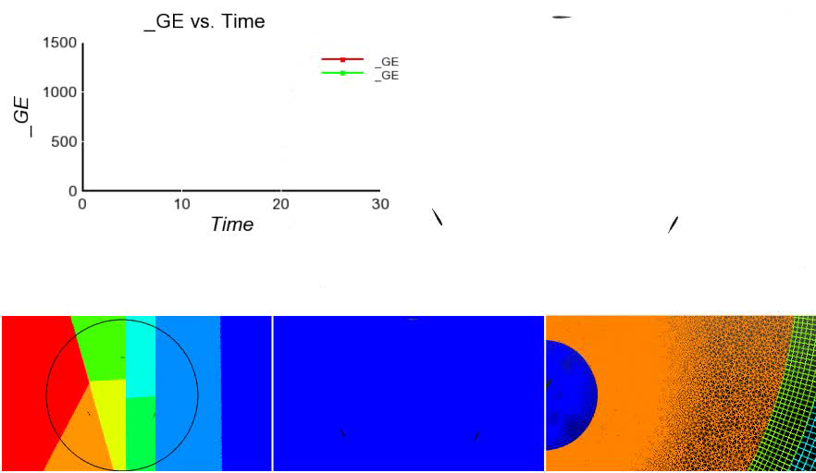
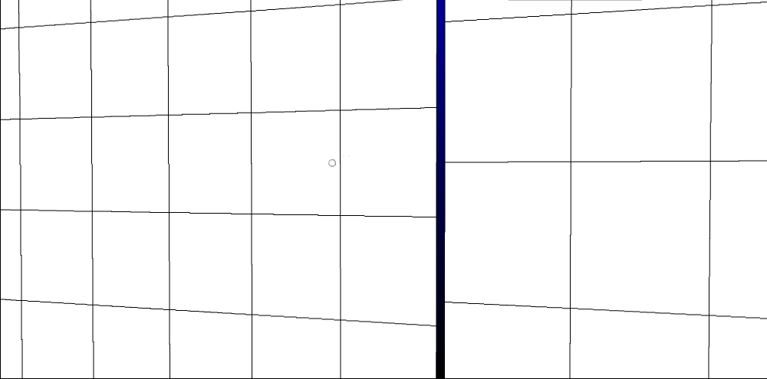
Halo-based Approach for Non-Conformal Interfaces
Has the “flavor” of an overset method; i.e., extrusion of surface mesh to opposing domain with reconstruction of states
Two-pass algorithm: surface_1:block_2 and surface_2:block_1
See extrusion-based method of Blades and Marcum, Int. J. Numer. Methods Fluids (2006) and Dodds, Imperial College Ph.D. (2016)
First implemented in low-Mach Nalu for wind-energy applications
Requires prescribed movement - OWC
Nalu EBVC Vertical Wind Axis Turbine

Slide 3
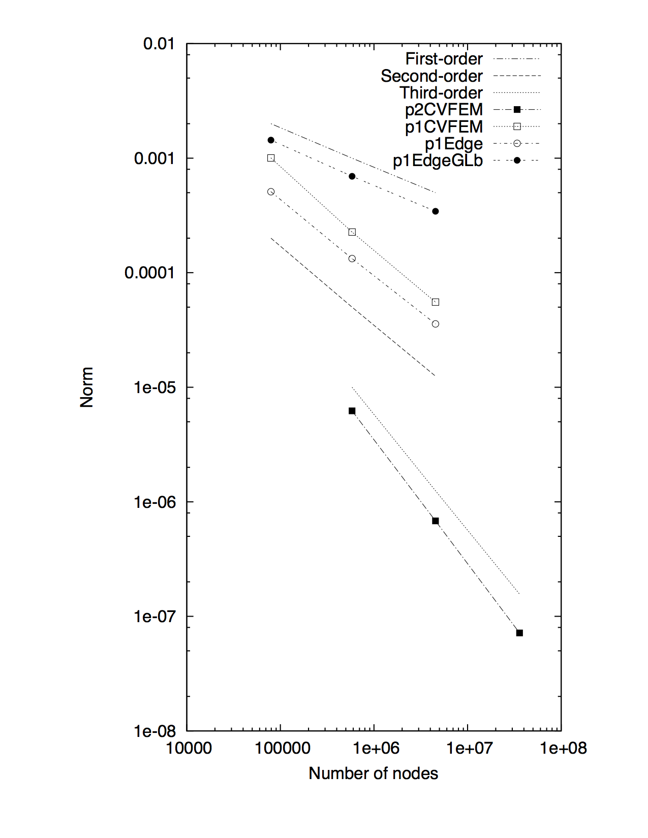
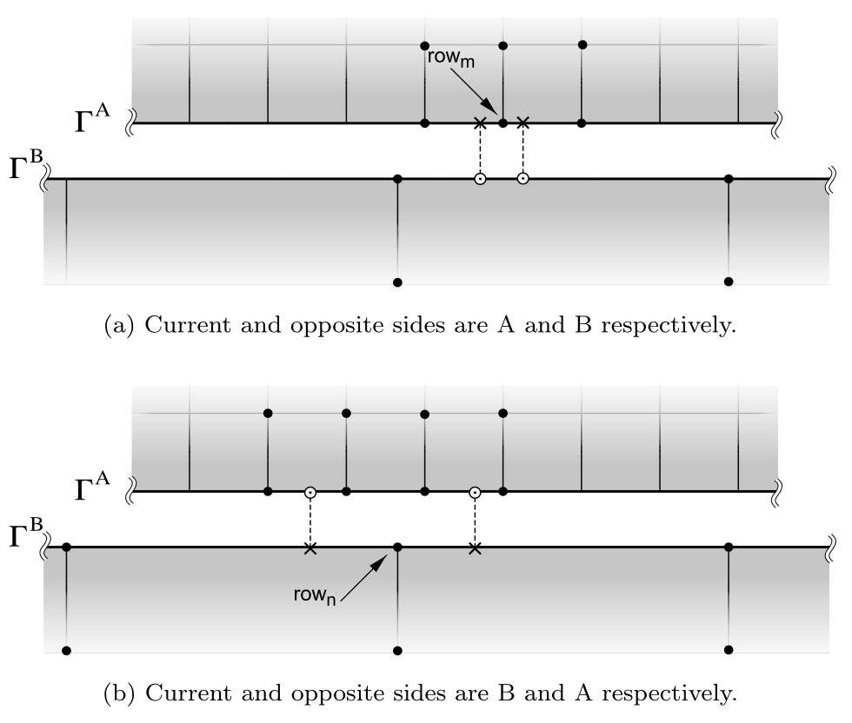
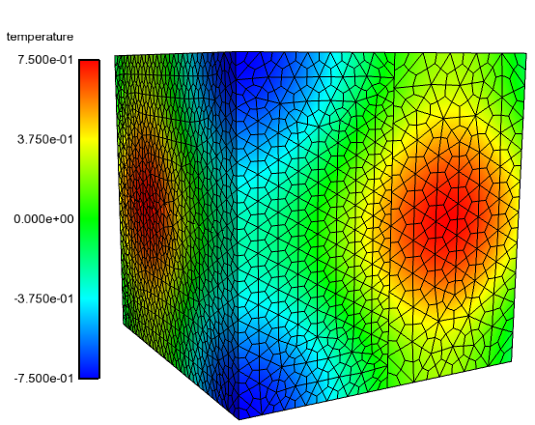
Design-order Mesh Constructs for Non-Conformal Interfaces
Non-conformal and overset methods provides ease of meshing and, when required, mesh motion
Design-order hybrid DG/CVFEM established, see Domino, J. Comput. Phys. (2018)
Again, requires prescribed movement - OWC
Non-conformal MMS
Current/Opposite

Slide 4
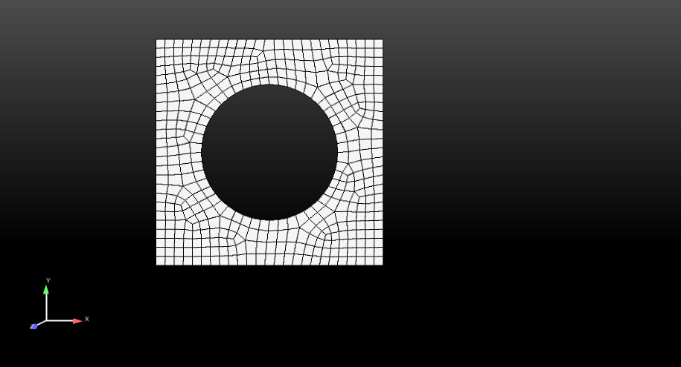
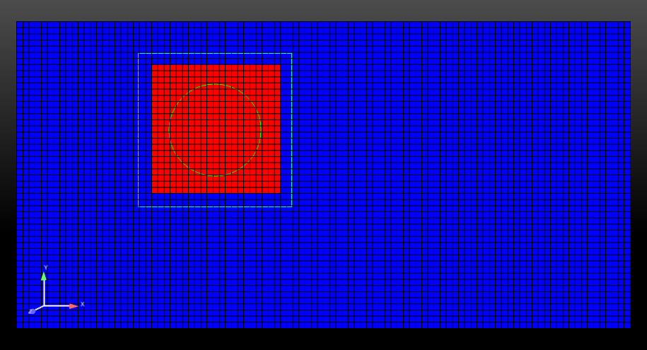
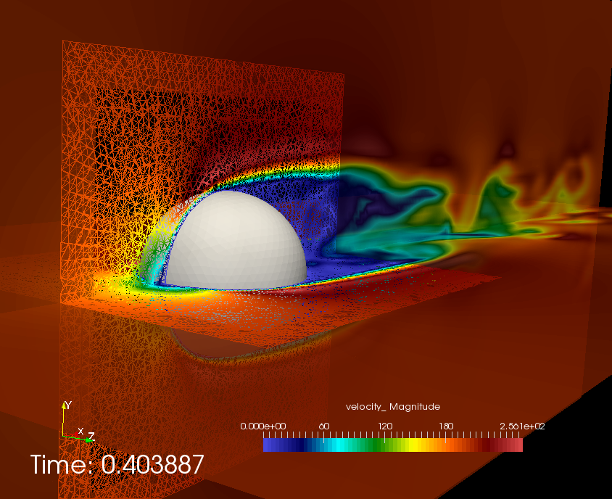
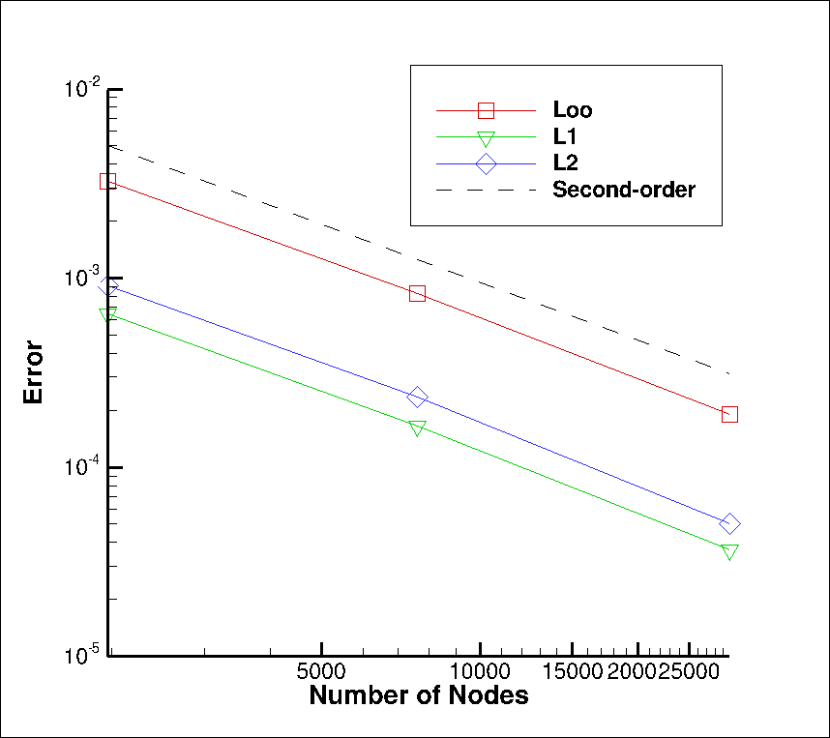
Overset: Freedom for Generalized Motion
Implicit, constraint-based overset-based approach (DG/CVFEM-based, started)
Does not require presumed movement
Similar to Nalu-Wind’s Sharma et al, J. Comput. Phys. (2021), however, STK-based search
BLOCK_2
BLOCK_3 (newly declared and
changed part)
Constraint-based
BLOCK_1
Surface_1 (read in)
Surface_101 (newly declared and changed part)
Fluids Hex/Tet
MMS

Slide 5
Overset: Freedom for Generalized Motion
Implicit, constraint-based overset-based approach (DG/CVFEM-based, started)
Does not require presumed movement
Similar to Nalu-Wind’s Sharma et al, J. Comput. Phys. (2021), however, STK-based search
BLOCK_2
BLOCK_3 (newly declared and
changed part)
Constraint-based
Fringe
BLOCK_1
Surface_1 (read in)
Surface_101 (newly declared and changed part)
Fluids Hex/Tet
MMS

Slide 6
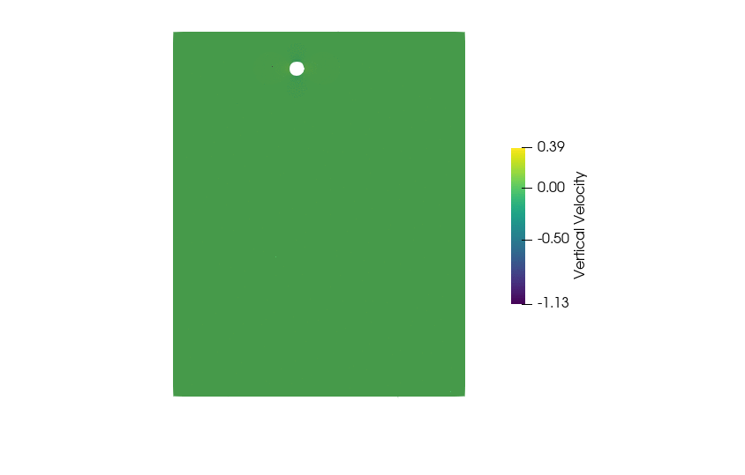
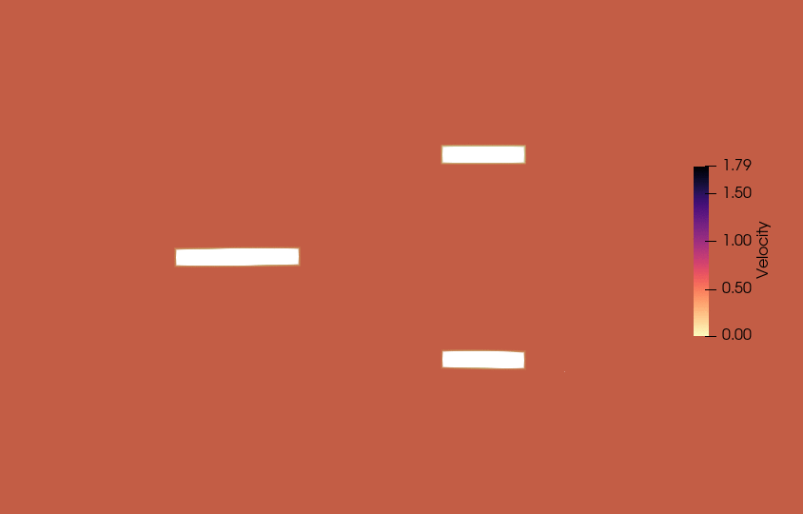
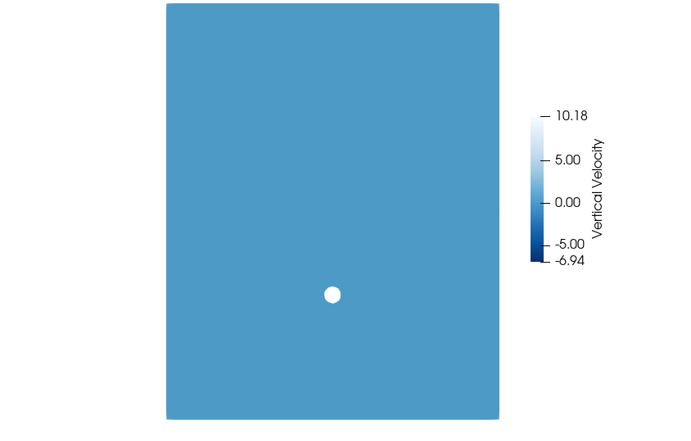
Six-Degree of Freedom (6-DOF)
Force and moments on a body drive motion follows Horne and Mahesh, J. Comput. Fluids, (2019); RK4 integration
Sliding mesh, three-blade example using six-DOF (left) and overset failing/rising sphere (right)

Slide 7
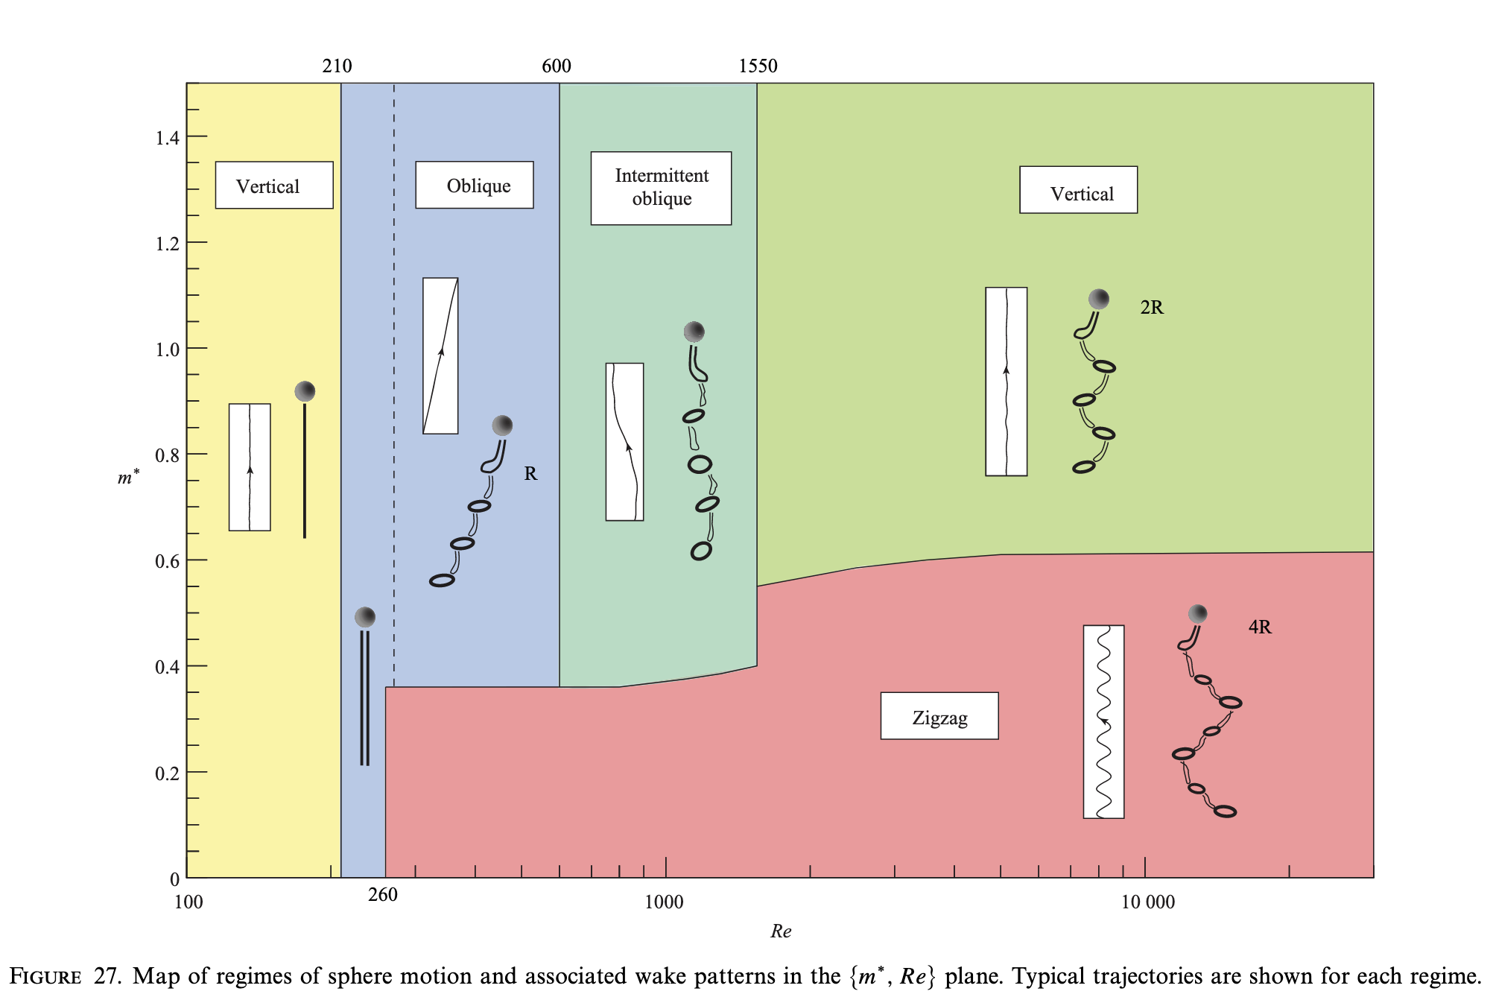
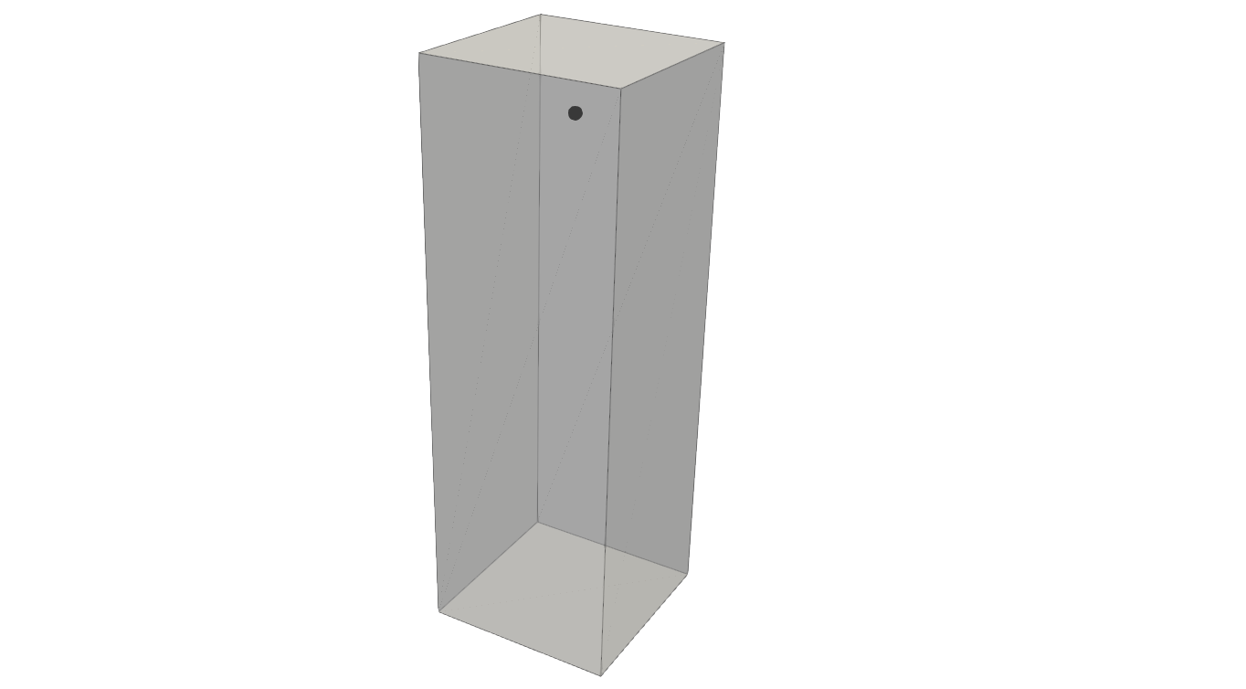
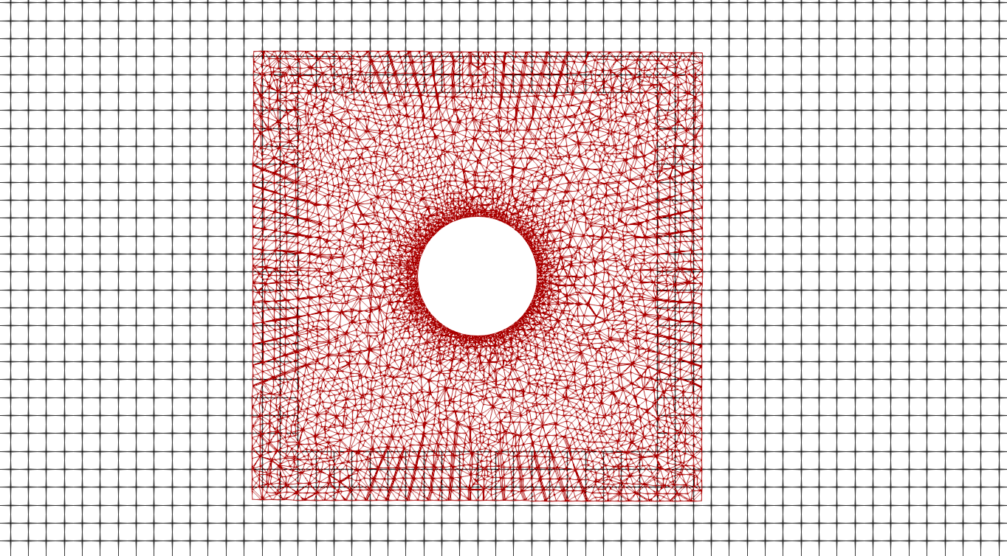
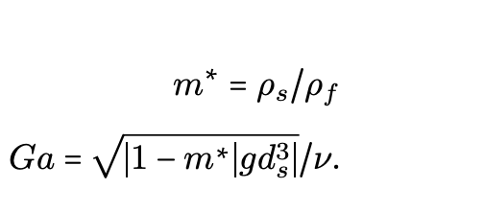
Overset Rise and Fall: Establish Stability of Overset
Galileo number dependency run for rise and fall
Comparisons to Horowitz and Williamson, “The effect of Reynolds number on the dynamics and wakes of freely rising and falling spheres”, J. Fluid Mech (2010)
45 d_{s}
Horowitz and Williamson (2010)
Heterogeneous mesh construct
(Hex8/Tet4)
15 d_{s}
15 d_{s}

Slide 8
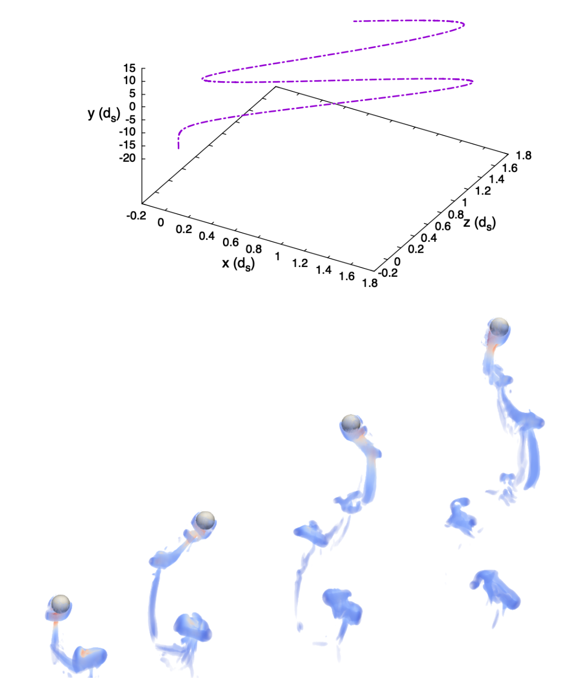
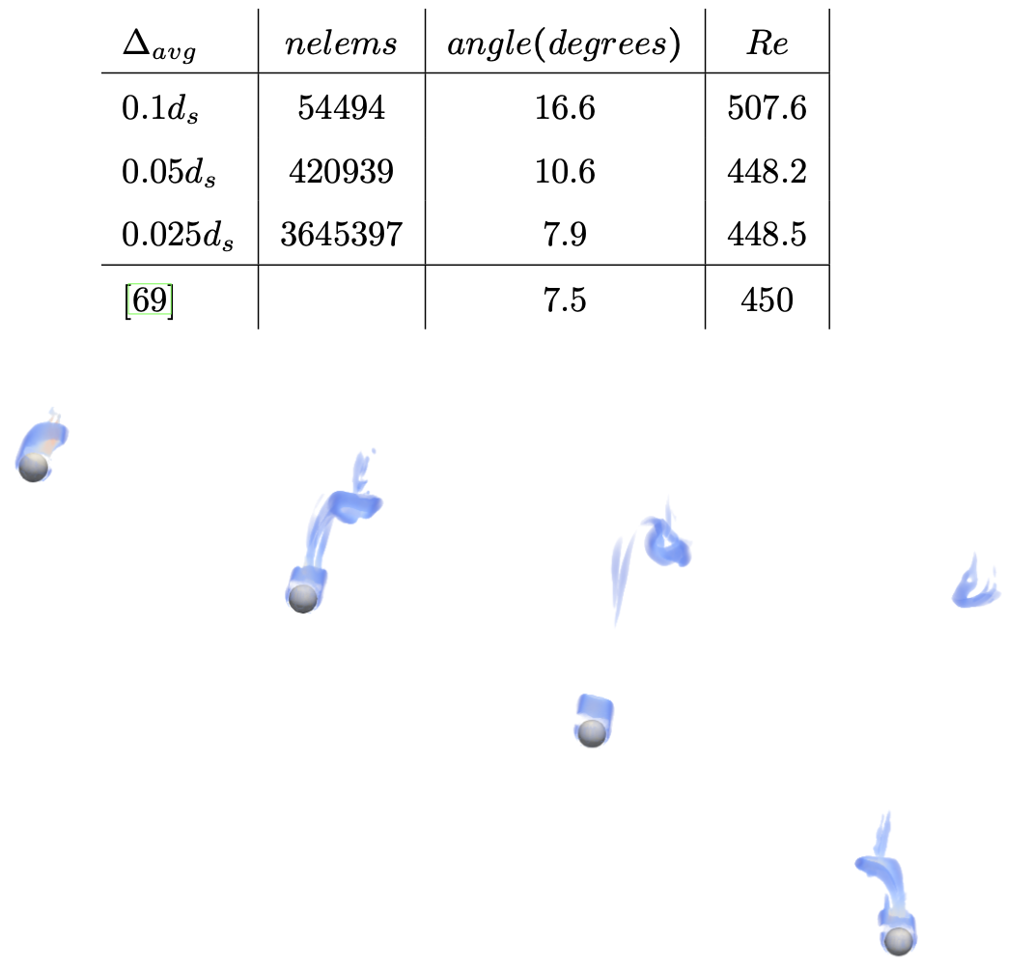
Overset Rise and Fall: Validation Results
Falling: Ga = 160.7, m = 1.41
QoI: Angle?
Rising: Ga = 476, m = 0.27
QoI: Zig-zag and four-mode
In Nalu, stable - despite such a low mass sphere that
exhibits highly energetic motion: known issue

Slide 9
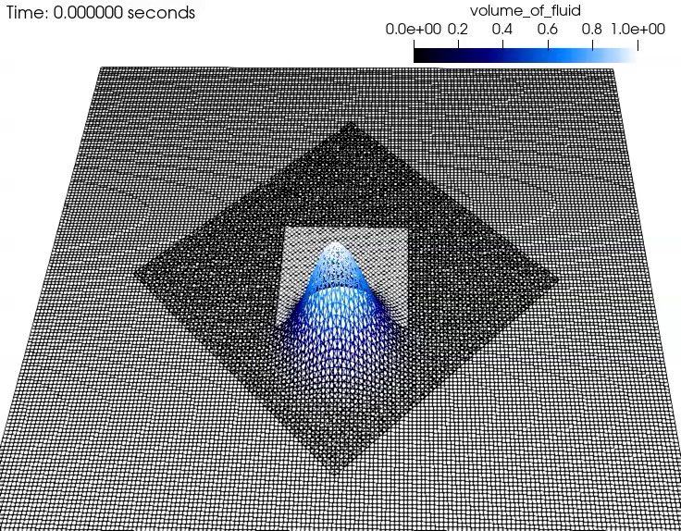
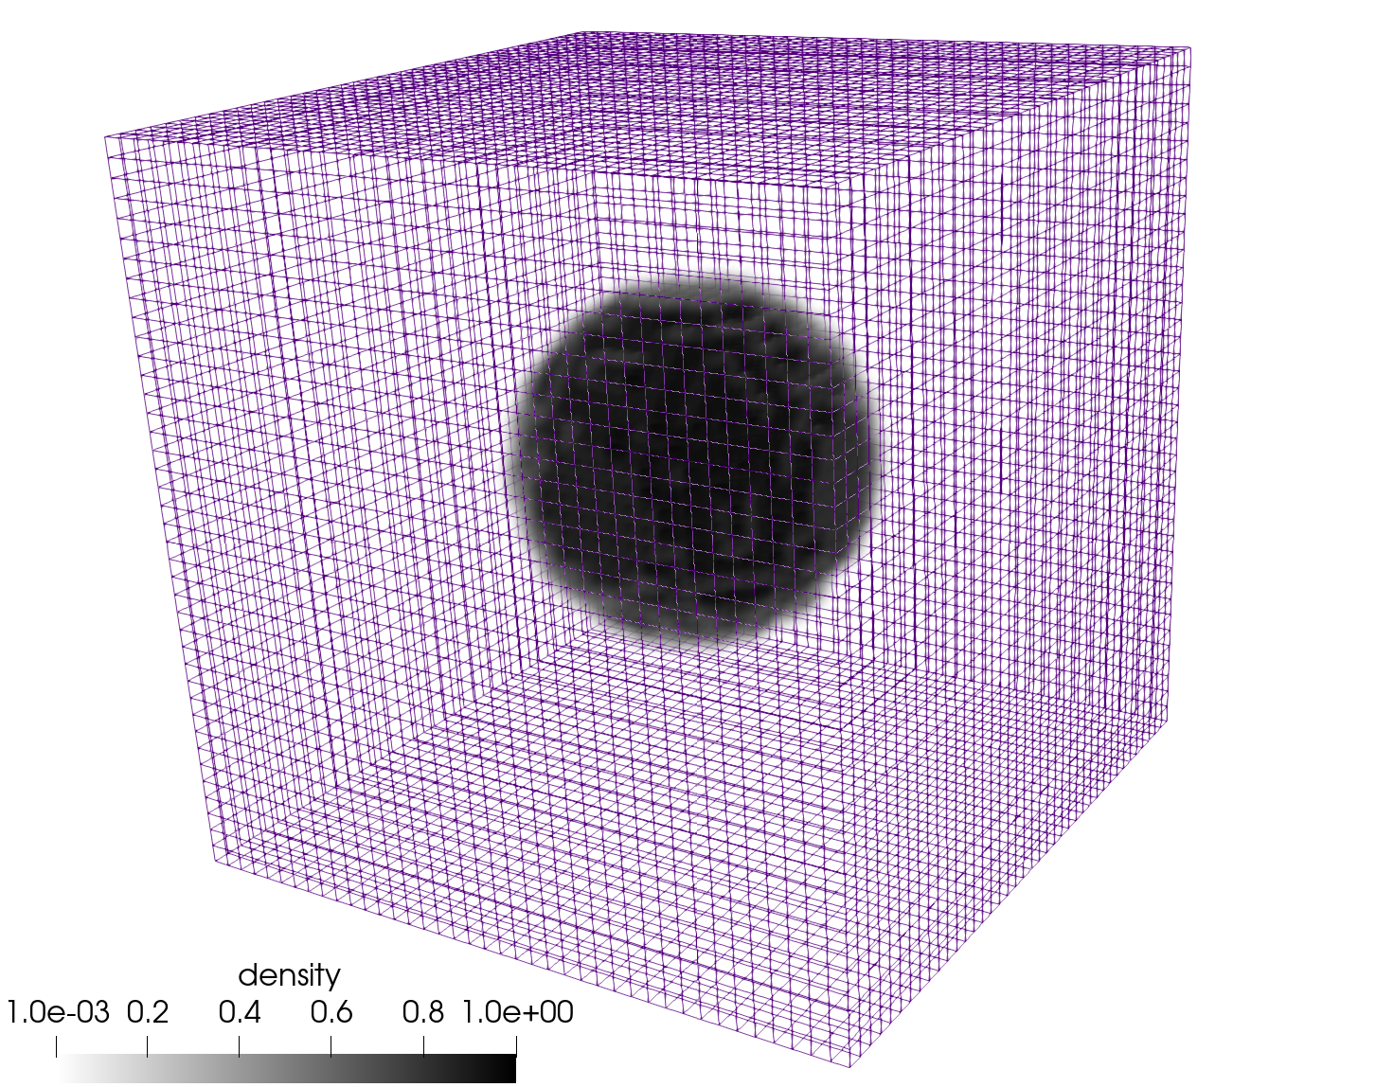
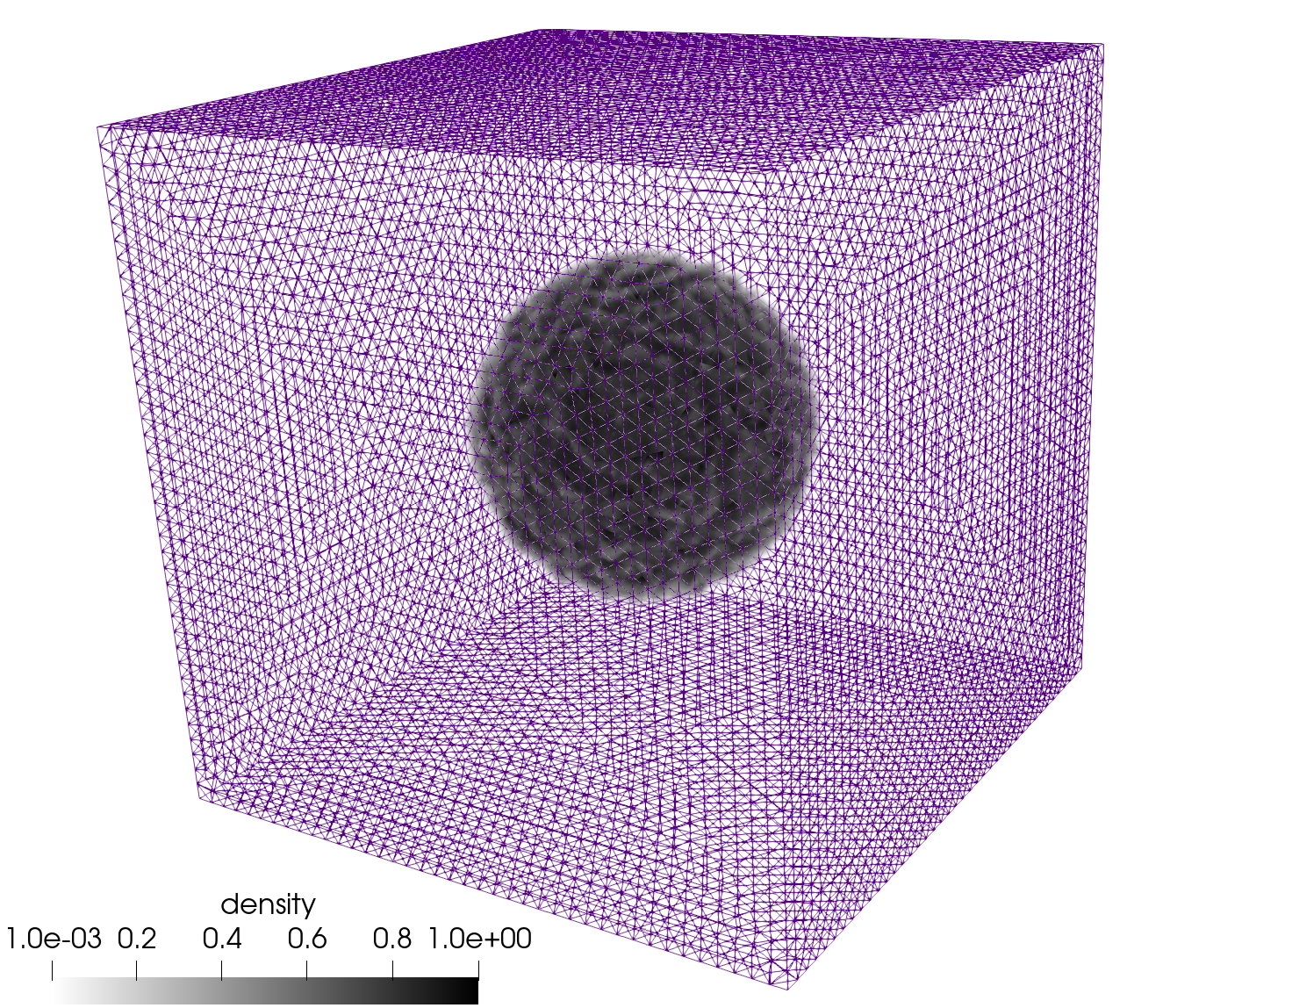
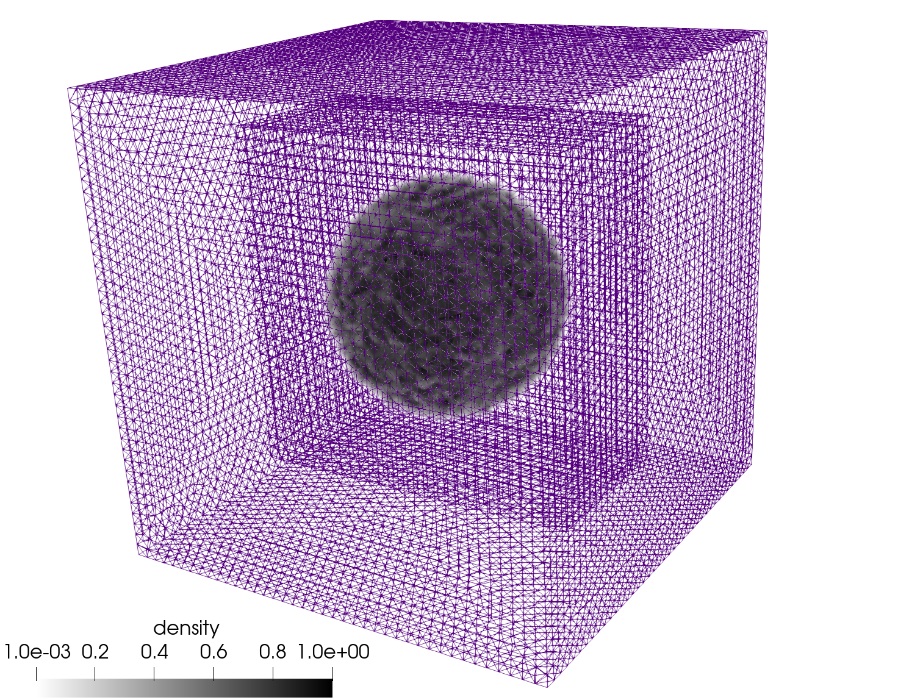
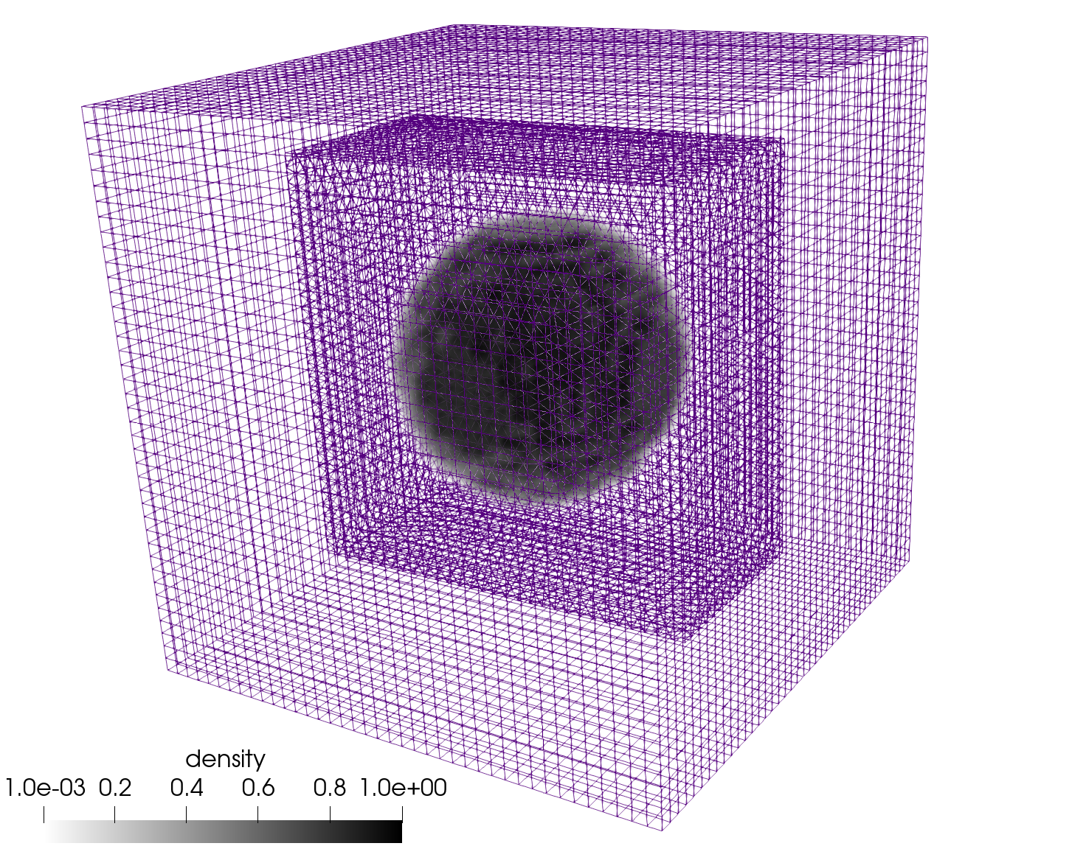
Objective: Overset + Volume of Fluid (VOF)
Molenkamp verification case, now with overset
Static bubble (computed curvature)
Hex8, Tet4, and Hex8/Tet4 Balanced Force
static bubble; density ratio = 1000

Slide 10
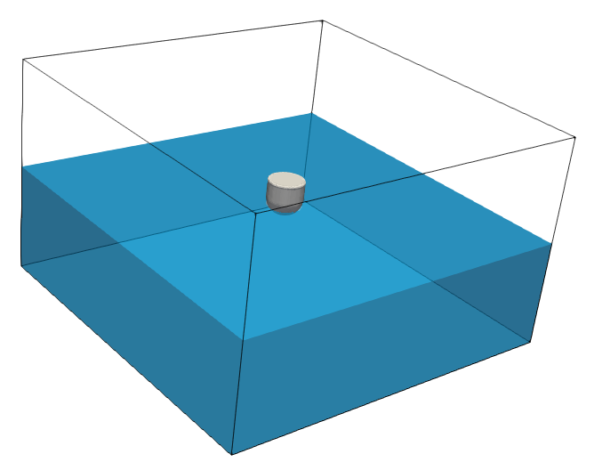

Validation: Unmoored Buoy Drop (Quiescent Conditions)
Comparisons are made to experimental data from the UK Centre for Marine Energy Research (UKCMER) of the WEC vertical displacement given in Ransley et al., Renew. Ener. (2017) who exercised a mesh deformation construct
5 m
5 m
0.5 m
3 m
0.25 m
0.25 m

Slide 11
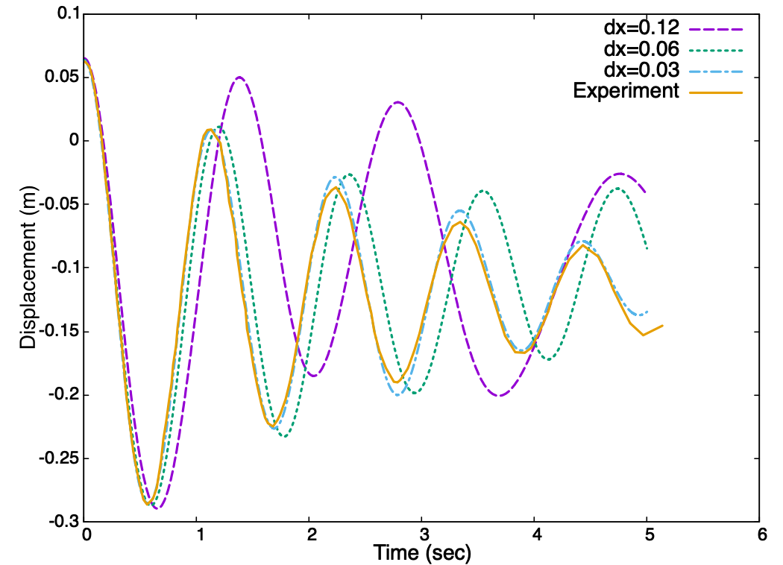
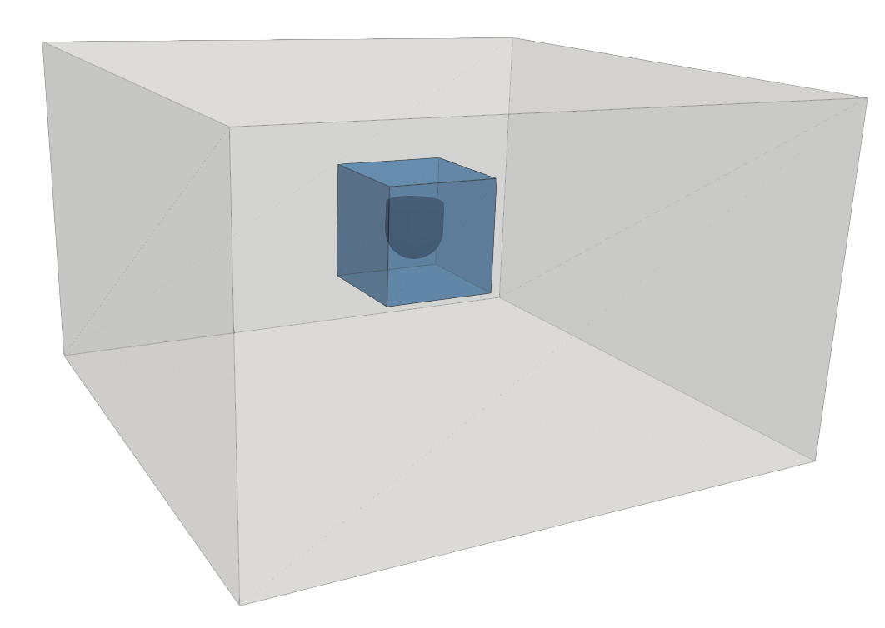
Validation: Unmoored Buoy Drop (Quiescent Conditions)
Objective: Compare to experimental dataset and demonstrate grid convergence
Displaced buoy vertically; QoI: center of mass spatial location as a function of time
Finding: Improved comparison over other works found in literature, e.g., WEC vertical displacement given in Ransley et al., Renew. Ener. (2017)
0.31 m

Slide 12
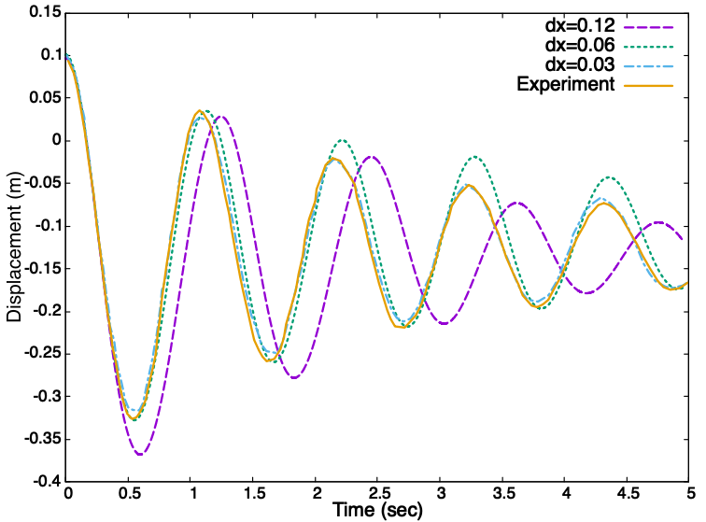
Validation: Moored Buoy Drop (Quiescent Conditions)
Objective: Compare to experimental dataset and demonstrate grid convergence – now tethered
Displaced buoy vertically; QoI: center of mass spatial location as a function of time
Similar Finding: Improved comparison over other works found in literature, e.g., WEC vertical displacement given in Ransley et al., Renew. Ener. (2017)
0.31 m
k = 500 N/m spring force

Slide 13
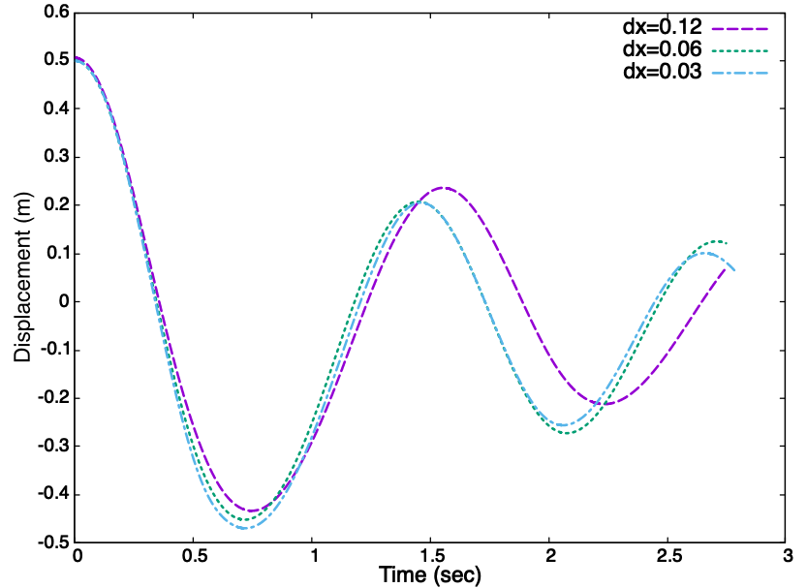
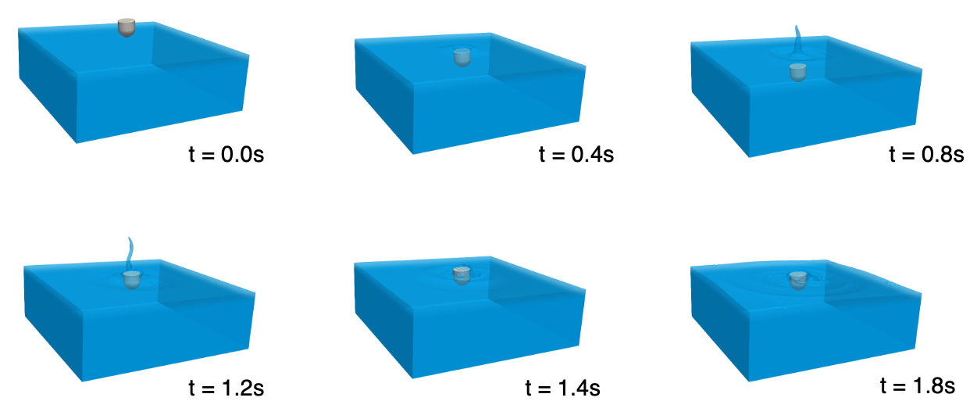
Buoy Dropped Into Quiescent Pool; large displacement limit Validation Benchmark, Domino and Horne, Renew. Energy (2022)
Large-displacement sample case run that can serve as a numerical benchmark

Slide 14
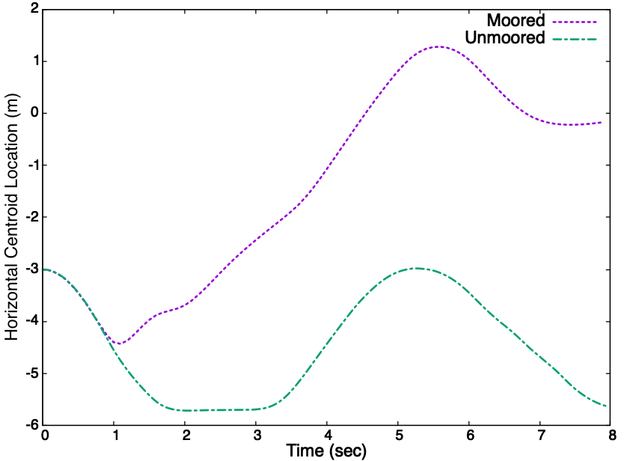
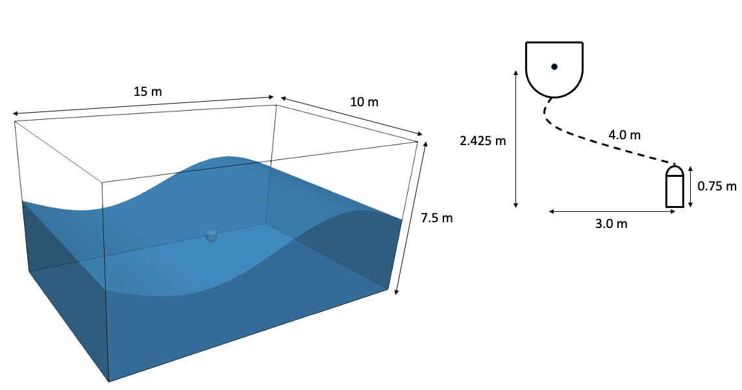
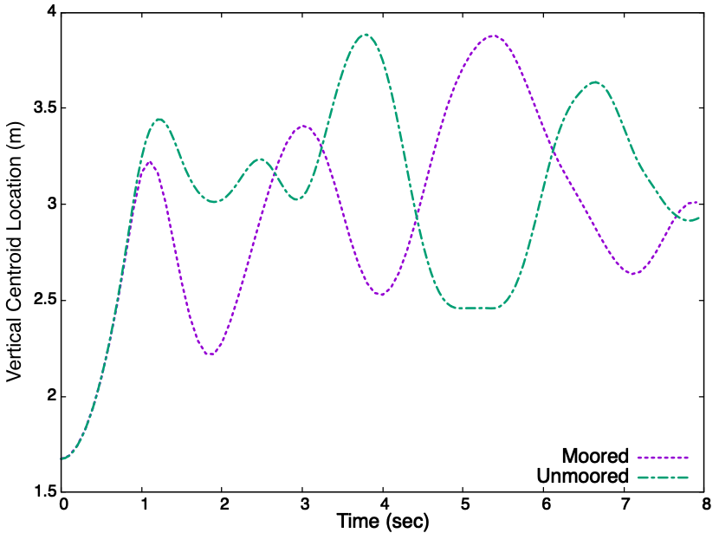
Buoy Subjected to large Wave-Form Validation Benchmark, Domino and Horne, Renew. Energy (2022)
Large-displacement sample case run that can serve as a numerical benchmark for the community; with and without mooring
Geometric center = f(t) relative to the tether’s mounting point

Slide 15
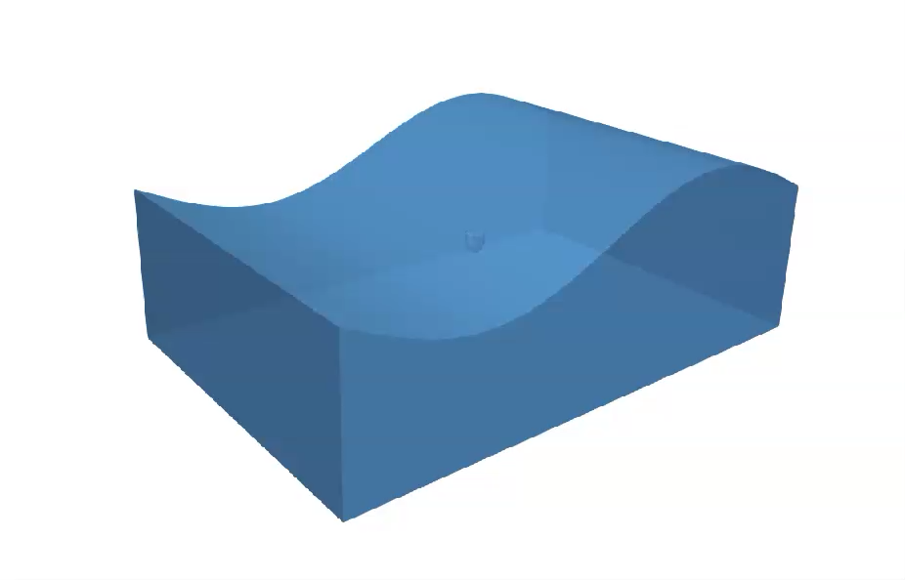
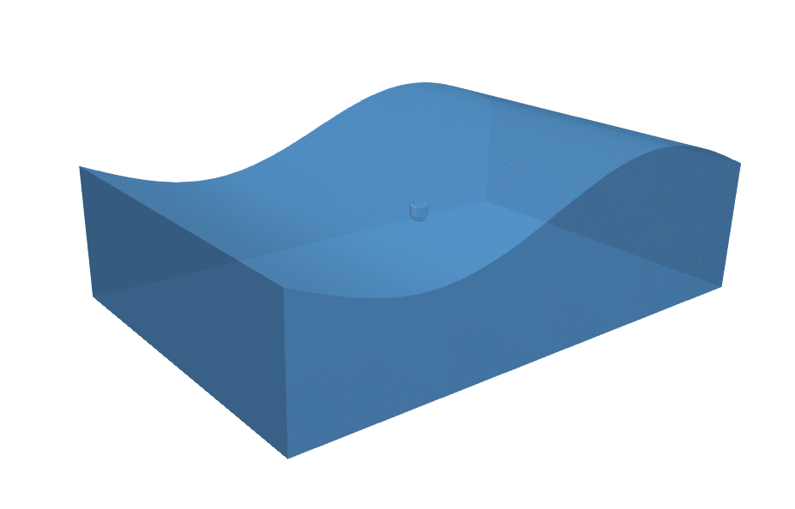
Buoy Subjected to large Wave-Form Validation Benchmark: Without (left) and With (right) Mooring

Slide 16

Buoy Subjected to large Wave-Form Validation Benchmark: Explore Center of Mass
High COM
Low COM

Slide 17
Conclusions
Although less complex from a physics perspective, development of a WEC mod/sim tool is complex
Critical Attributes include: solid core numerical discretization, VOF transport, and mesh motion coupling
Credibility established for the three components
Novel residual-based stabilization provided for VOF use case
Improved validation for free and moored buoy drop
Simulation tool is well-posed to contribute to sustainable renewable energy designs

Slide 18

Acknowledgements
Wyatt Horne, Computational Thermal and Fluid Mechanics (1541)
Leveraged six-DOF + Overset expertise
Team member, co-author
Sandia’s Advanced Scientific Computing (ASC)
Exascale Computing Project
Water Power Technologies Department (8922); staff Jesse Roberts and Chris Chartrand
Stanford CTR and ICME, including:
Professor Parviz Moin,
Susan Dorman, and
Mikayla Booker
( )
PSAAP-2

Slide 19
Building a Credible, Open-source High-fidelity Computational Fluid Dynamics Tool Suitable for Renewable Wave Energy Applications
In this presentation, an unstructured, low-Mach, balanced-force, volume of fluid numerical methodology is overviewed whose prime objective is to target the modeling of wave-based renewable energy devices using high-fidelity computational fluid dynamics approaches. A control volume finite element numerical discretization, which includes novel residual-based stabilization for the volume of fluid equation, is established. Although WEC mod/sim requirements lack typical multiphysics complexities, other technical challenges exist, such as ensuring non-diffusive fluid transport in the presence of mesh modification and modeling floating devices that are free to move in a non-prescribed trajectory. The presentation outlines three critical components of a WEC mod/sim tool including 1) stable and accurate unstructured low-Mach fluid mechanics discretizations, 2) low-dissipation volume of fluid transport in the presence of PDE-based sharpening, and 3) mesh motion methodologies that encompass mesh deformation, sliding mesh, and overset approaches. Credibility of this numerical approach is established in the open-source Nalu simulation tool by deploying a code verification and model validation hierarchy across the intersection of the three critical components. A formal buoy validation case, with and without mooring, is presented, in addition to validation benchmark cases that reside in the high-displacement regime. These validation cases showcase an implicit overset unstructured mesh construct that allows a wave energy converter (WEC) geometry to freely move about a background domain, thereby establishing the efficacy of the approach in this challenging multiphase flow application.
Dr. Stefan Domino’s research interest rests within low-Mach fluid mechanics methods development for complex systems that drive the coupling of mass, momentum, species and energy transport. His core research resides within the intersection of physics model development, numerical methods research, V&V techniques exploration, and high-performance computing and coding methods for low-Mach turbulent flow applications. In support of his Adjunct Professor appointment within the Institute for Computational and Mathematical Engineering, Stefan also supports the co-teaching of ME469, Computational Methods in Fluid Mechanics, while continuing his primary career at Sandia National Laboratories (NM) as a Distinguished Member of the Technical Staff. Stefan earned his Ph.D. in Chemical Engineering (2000) from the University of Utah, where he also supported the technical objectives of the ASCI Alliance Center, C-SAFE.
SNL is managed and operated by NTESS under DOE NNSA contract DE-NA0003525
-

